Slide 1
Robo Advisor Application
Adam Jimenez, Vincent Sgarzi, Baha Amour, Kunal Srinivasan

Slide 2
Executive Summary
The Robo Advisor Application created by the group aims to allow the user to analyze stocks they are interested and receive trading recommendations for each stock
The app allows the user to select companies that are of interest to them from an easy to scroll list of stocks, assign desired weights to each and specify desired investment amounts
Features of the app allow the user to review the performance of the stocks in terms of historical prices and find recent news related to the company
The application presents a pseudo portfolio view based on their selections to show how their investments would have grown over time in the past
The advisory feature of the app uses DMAC algorithm and machine learning to make buy/sell recommendation for the next day based on estimated stock prices

Slide 3
Application Flow
User selection of Stock Cos
Visual Module
Stock overview
ML Module*
SVC Model
User specified portfolio weights
API Call for Stock History & Related News
Portfolio Dashboard
Logistic
Algorithm for model comparison & price forecast
Decision Tree
User specified investment amount
Robo Advisory
Time Series Forecast
* We also explored ARIMA modeling technique for forecasting

Slide 4
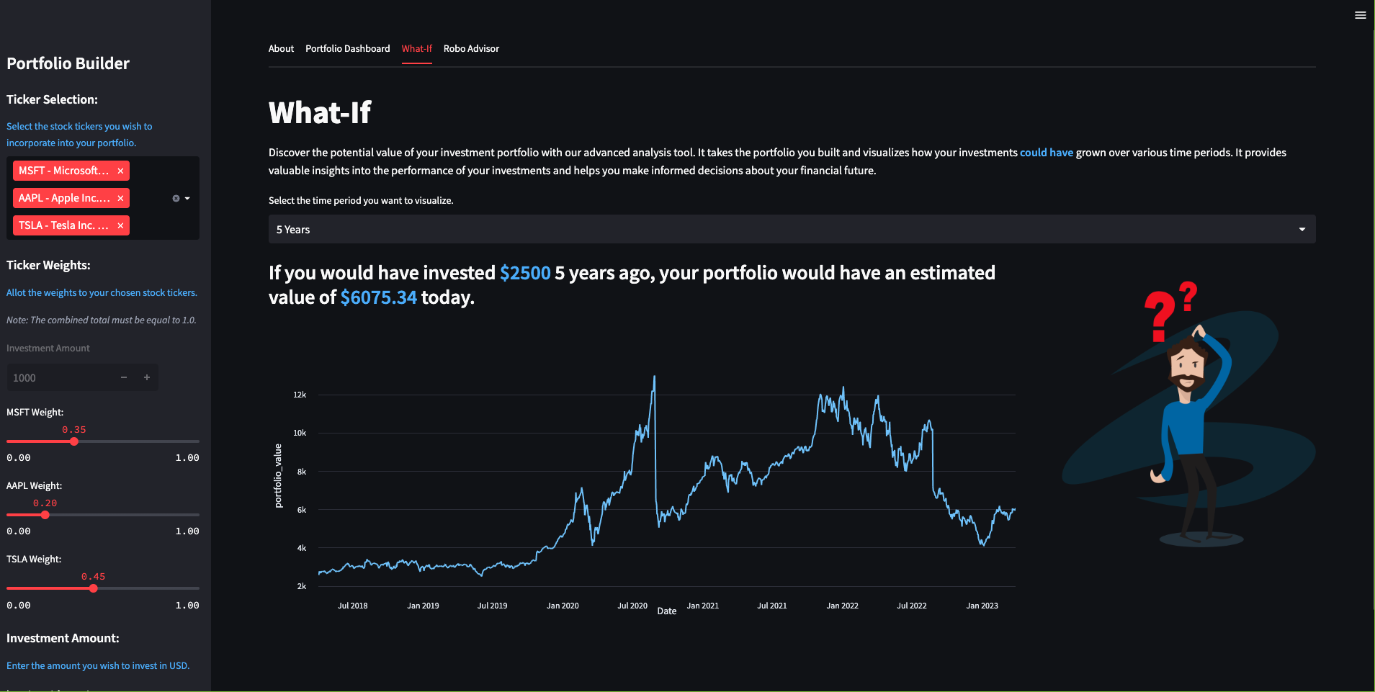
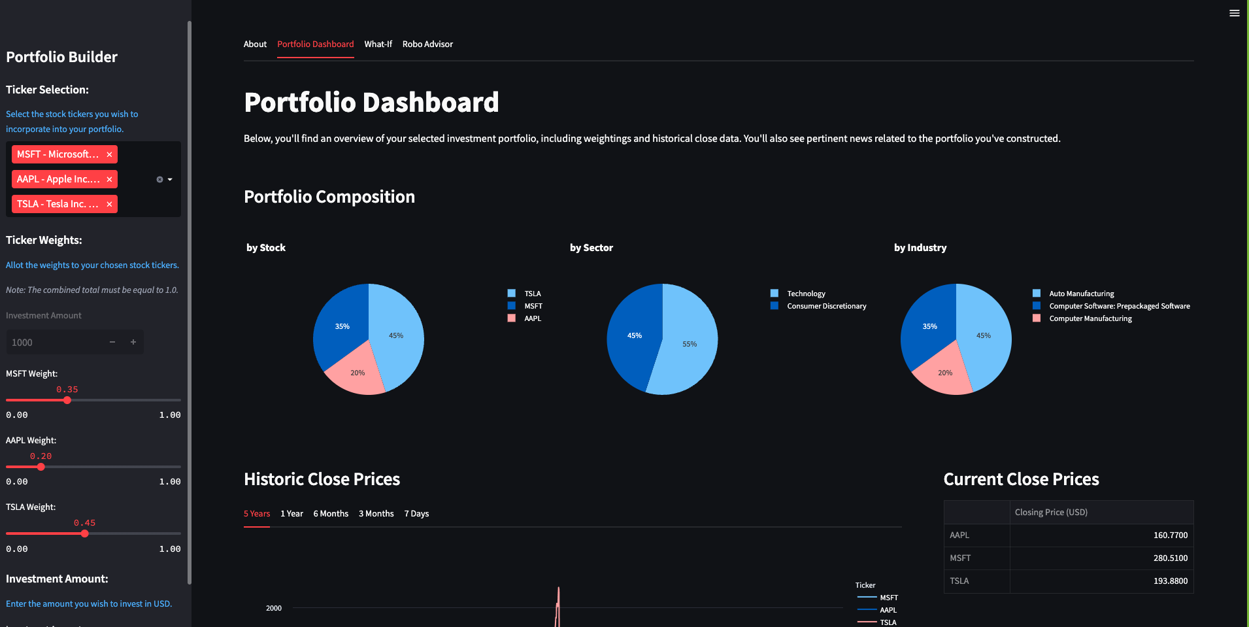
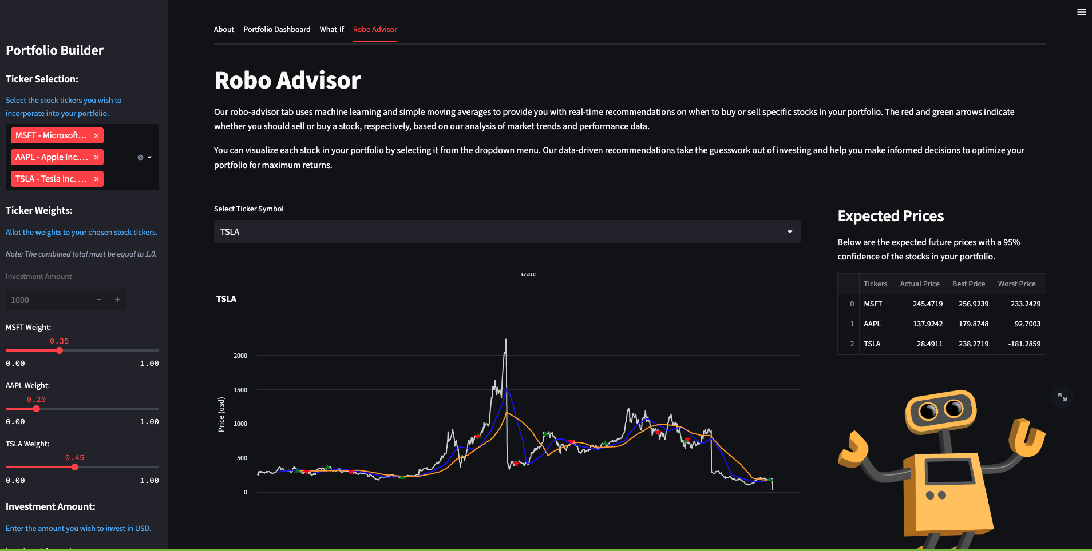
Application Snapshots

Slide 5
Data Preparation & Model Training
Data source: ALPACA API
Data collection: User feed from the frontend is used to create a list of stock tickers for API pull
Data preparation: For machine learning models like SVC, Decision Tree and Logistic we use features based historical returns including technical indicators like
Smoothed simple moving average (SSMA)
Exponential Moving Average (EMA),
Double exponential moving average (DEMA),
Triple exponential moving average (TEMA),
Triangular moving average (TRIMA) &
Simple moving average (slow and fast) SMA
Training process:
Development: Modeling process uses last 24 months of data for each stock ticker to ensure adequate sample size and recency value
Training: Initial 6 months of development sample. Initial testing show improvements in model predictability as the development sample window increases
Testing: Remainder of the development sample was used for testing

Slide 6
Model Evaluation
During the development of the application, several models were evaluated. Since stock prices and returns are impacted by impacted by myriad of factors other than temporal features and also subject to randomness, making predictions can be a very complex exercise.
The main purpose of the ML models was to generate the best prediction for future prices, that would feed the Robo Advisory feature. We explored,
Support Vector Machine/Classifier- SVC
Decision tree
Logistic
Time Series Forecast
Autoregressive Integrated Moving Average- ARIMA
SVC, Decision tree & Logistic regression models are best suited for classification problem and were used to predict return signals for the next day. Our use of the predicted signals was supplemented with naive estimate of future returns. Time Series Forecast modeling uses historical price and breaks it down into various components like trends, cycles, seasonality. The components are then used to make predictions about future prices. ARIMA modeling is another time series modeling technique which is used for series with temporal dependence. But the technique works under assumptions like stationarity and autocorrelation.
The algorithm evaluates the results of the classification models and selects the best prediction by comparing model accuracy, precision and recall for the purpose of automation. The use of Time Series Forecasting has been quite challenging in our test runs due to high degree of randomness and volatility in the dependent variable. Evaluation of ARIMA modeling technique highlighted that similar to other temporal forecasting techniques successful implementation of ARIMA models requires careful case by case consideration of each stocks historical performance.`

Slide 7
Future Application Updates
Enhancements to portfolio dashboard to include company financial attributes
Add key events calendar
Application runtime efficiency
Live trading functionality
Backtesting of trading strategy
Refine data source: During testing, it was noted that the historical data from the source API did not adjust for events like stock split. This affects the model prediction outcomes and portfolio overview

Slide 8
Appendix

Slide 9
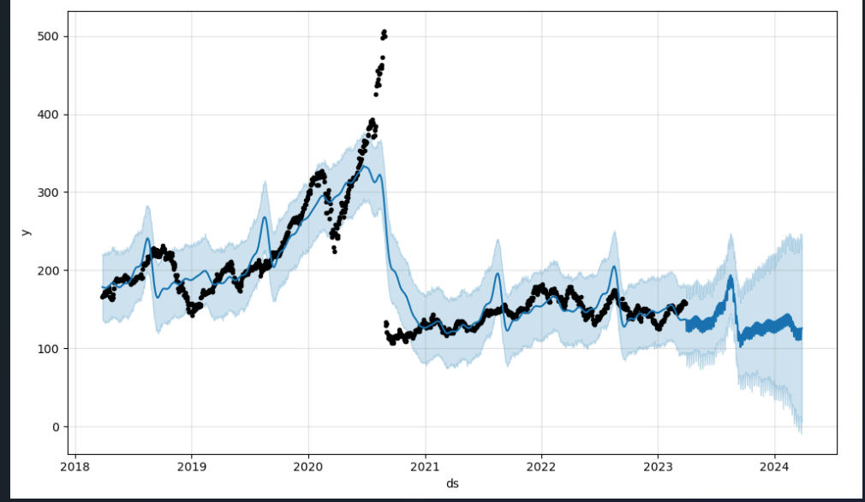
Appendix: Performance of Time Series Forecasting on Stock Prices

Slide 10
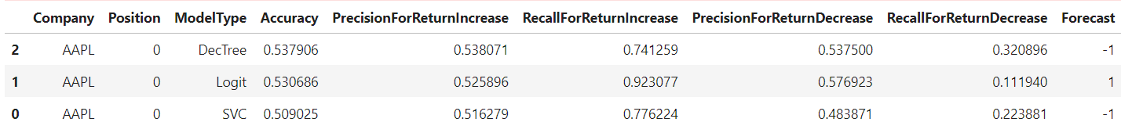
Appendix: Model Comparison Summary Sample

Slide 11
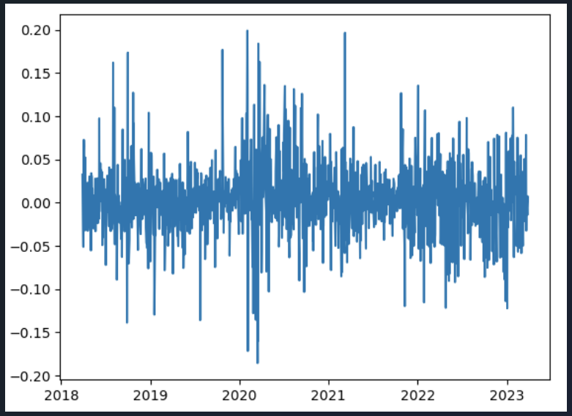
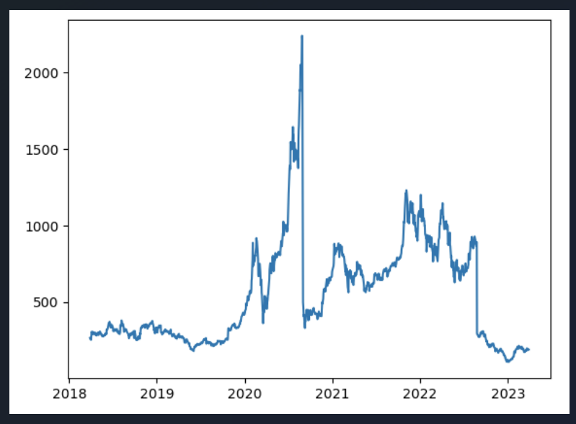
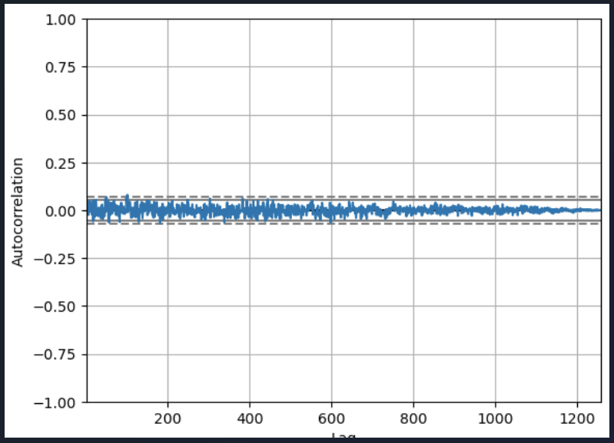
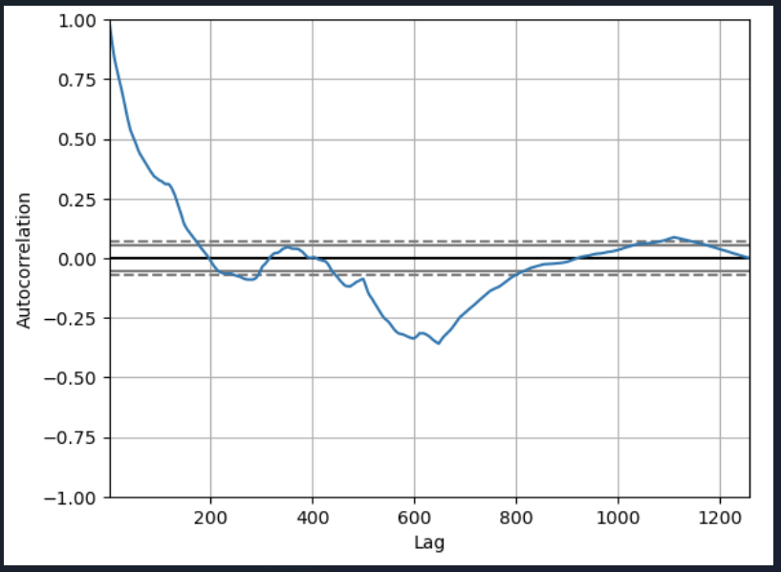
Appendix: Evaluation of Time Series for ARIMA Modeling
Stock Returns
Stock Prices
Stationarity
Autocorrelation

